Slide 1

Maze Solver
Green University of Bangladesh
CSE 304 – 213 D1

Slide 2



Sudip Ghoshal
Lecturer
Green University of Bangladesh
Md. Tanjim Mahtab Taosif
213902007
Dept. of CSE
Irteja Mahmud
213902016
Dept. of CSE

Slide 3
Introduction
Objective
User Interface
Key Feature
Maze Map
Implementation
Segments
Conclusion
Outline

Slide 4

Introduction
The Maze Solver Game project is an interactive text-based game designed to challenge players with navigating a maze.
The implementation involves intricate maze-solving techniques, user interface design, and efficient algorithms to ensure an enjoyable gaming experience.
This project is designed to showcase the implementation of a maze-solving algorithm using assembly language, specifically targeting the emu8086 environment.

Slide 5
Objective
The primary objective of our Maze Solver project is to demonstrate an efficient algorithm that can navigate through mazes of varying complexities.
We have created two different mazes - an easy one and a more challenging one - to illustrate the versatility and adaptability of our maze-solving algorithm.

Slide 6
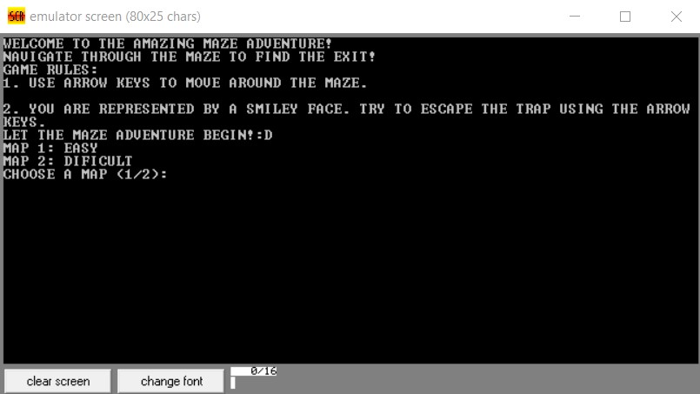
User Interface
Figure: Welcome Page of Maze Solver

Slide 7
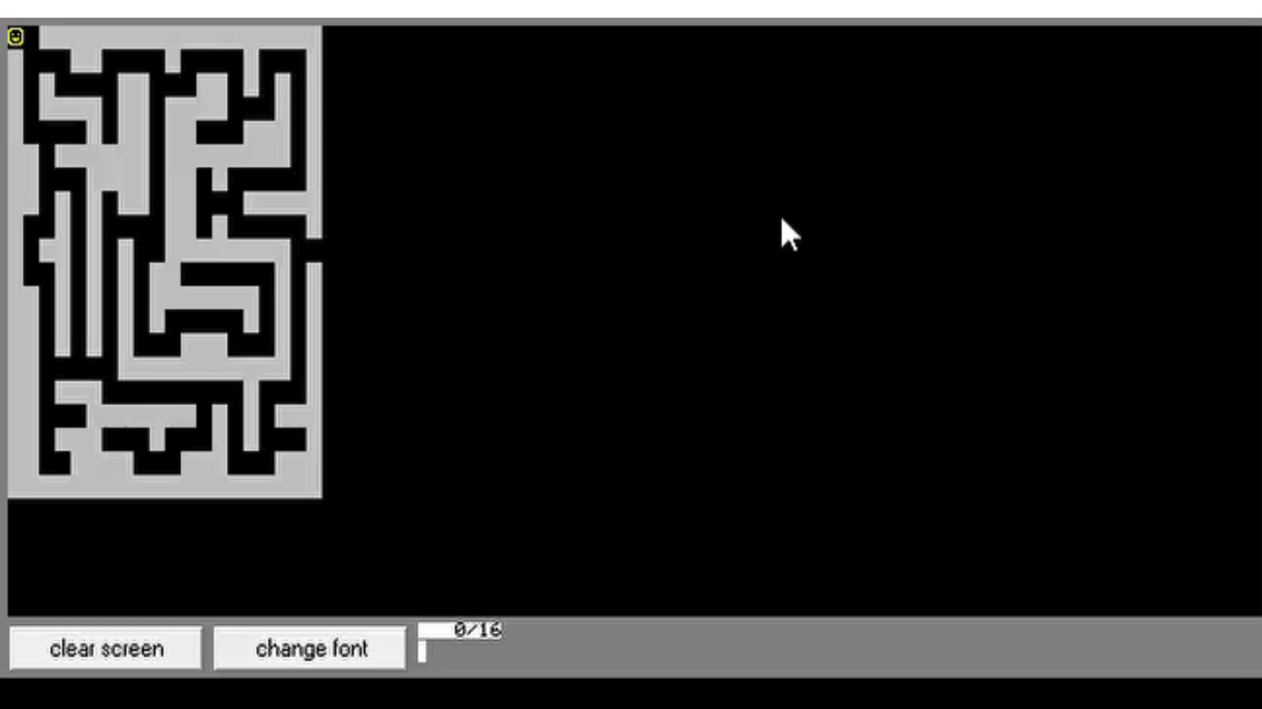
User Interface
Figure: Maze Map And Gaming Experience

Slide 8
Key Features
User-Friendly Interface
The project starts with a welcoming message, providing instructions and information about the game rules.
Users are prompted to choose between two maps - an easy map (Map 1) and a difficult one (Map 2).
Maze Representation
The mazes are represented using ASCII characters, making it visually appealing and easy to understand.
The maze maps are displayed on the screen, allowing users to visualize the challenge that the maze solver algorithm will overcome.

Slide 9
Key Features
3. Dynamic Maze Solver
The maze solver algorithm is implemented in assembly language, specifically for the emu8086 environment.
The algorithm dynamically adjusts to the chosen maze's size and complexity, providing a generic solution for different scenarios.
4. User Interaction
Users can control the movement of the maze solver using arrow keys, making it an interactive and engaging experience.
The program responds to user inputs in real-time, providing a seamless and immersive maze-solving adventure.

Slide 10
Maze Maps
We have created two distinct maze maps –
an easy map (Map 1) and
a challenging one (Map 2).
Each map is represented as a matrix of ASCII characters, where walls are denoted by "█" and open paths by spaces. Users can witness the maze solver algorithm in action as it navigates through the twists and turns of these mazes.

Slide 11
Implementation Details
The project is implemented in assembly language, with a focus on the emu8086 environment.
Macros are used to modularize the code and enhance readability, allowing for the efficient printing of maze maps.
The maze solver algorithm intelligently navigates through the maze based on user inputs and dynamically adapts to different maze configurations.

Slide 12
Segment
1. Macro
Two macros, map1 and map2, are defined for printing different mazes.
The print macro is used to print individual rows of the maze.
2. Data Section
3. Maze Maps
4. Initialization
The program starts by displaying a welcome message and prompting the user to choose between two maps (easy and difficult).
5. Game Loop
The main loop of the game is labeled game_loop.
It continuously checks for user input using the check_for_key routine.
Movement in the maze is handled by the move_maze procedure.

Slide 13
Segment:
6. Movement Procedures
Procedures like move_left, move_right, move_up, and move_down handle the movement of the player within the maze.
They check for walls and boundaries to determine whether the movement is allowed.
7. Interrupts and Screen Operations:
Int 10h is used for screen operations, setting the video mode, and printing characters.
Int 16h is used for keyboard input.
Int 1Ah is used for timing.
8. Game Loop
The main loop of the game is labeled game_loop.
It continuously checks for user input using the check_for_key routine.
Movement in the maze is handled by the move_maze procedure.

Slide 14
Conclusion
Versatile Application of Assembly Language: The Maze Solver project highlights the uses of assembly language in addressing complex algorithmic challenges, demonstrating its progress in programming and problem-solving.
Engaging User Experience: With a focus on user interaction, the project provides an immersive and enjoyable experience for both programmers and maze enthusiasts looking for a dynamic and interactive platform.

Slide 15
8086
Thank You
Any Question?
Read, in the Name of your Lord ...
Al-'Alak, 96:1

